Slide 1
Improving 3D Models
Improving 3D Models
Mikyla Carpenter, David Lembersky, Risako Owan, Ming Zi
Notes:
Hi everyone, thank you so much for coming to our comps presentation. I’m Risako Owan, and (each introduce themselves?)
And we are here to tell you about improving 3D models!

Slide 2

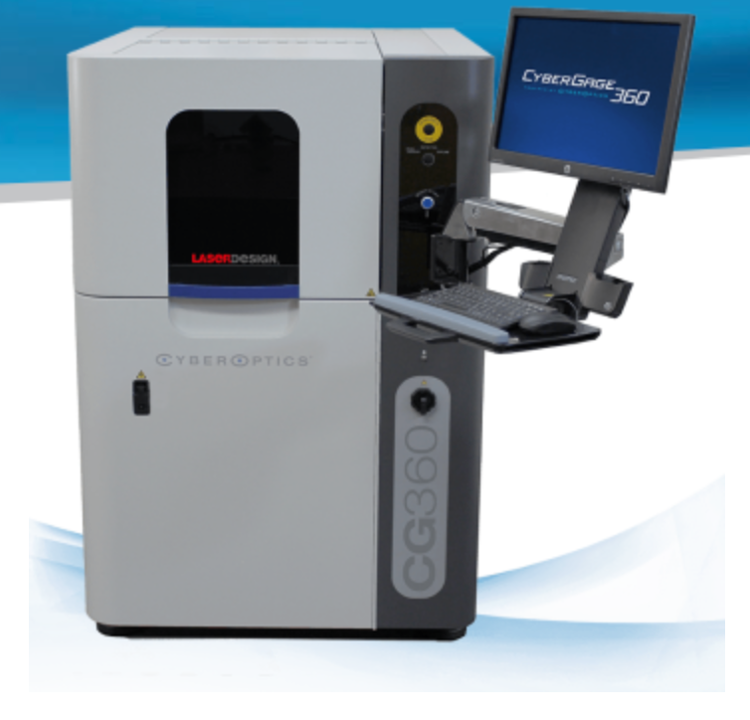
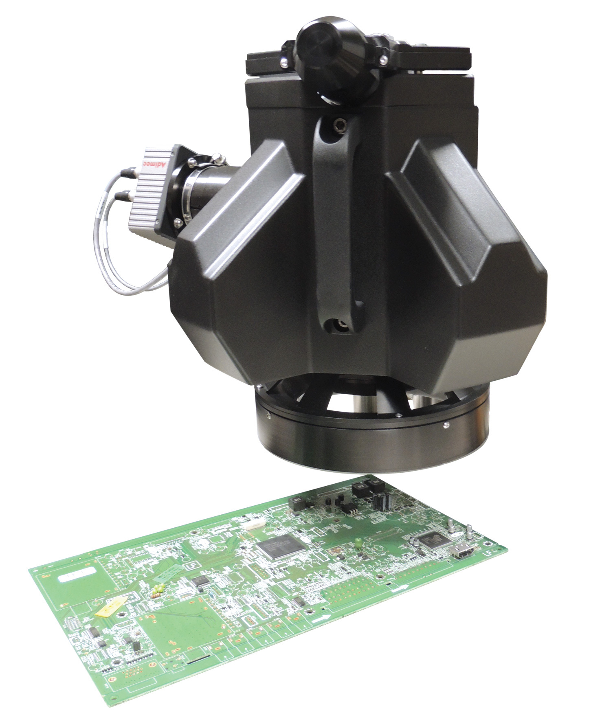
http://cyberoptics.com/
Notes:
Before we go into details about our work, we’d like to give you a bit of information on the background of our project.
Our project was given to us by CyberOptics, a company in Minneapolis, that operates as a leading global...
Method used when creating printed circuit boards
https://www.youtube.com/watch?v=ylk6VMBLrvM
https://www.youtube.com/watch?v=09DPBTe3Rz8

Slide 3
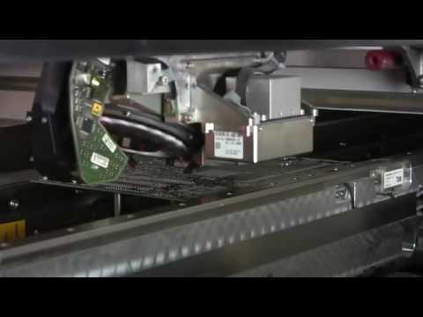
Notes:
To give you a better sense of how pcb are created, here is a short video:
As you can see, these boards are created at a very high speed. Naturally, we sometimes get defects, such as boards with a wrong component, crooked component, or even upside down components. However, these boards are created in a vacuum chamber to ensure that dust and air bubbles don’t get under the green printing or components. For this reason, it’s very time consuming for a worker to have to open up the vacuum chamber to inspect all the possible defects by hand.
This is where CyberOptic’s scanning machines come in.

Slide 4
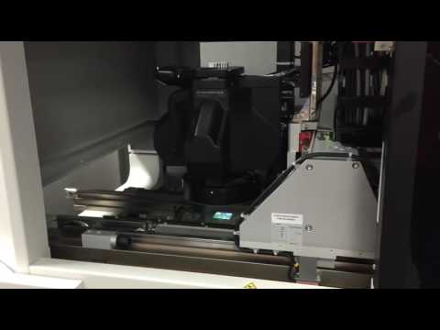

Slide 5
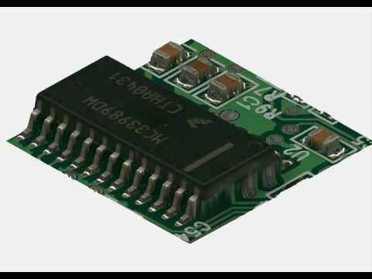

Slide 6
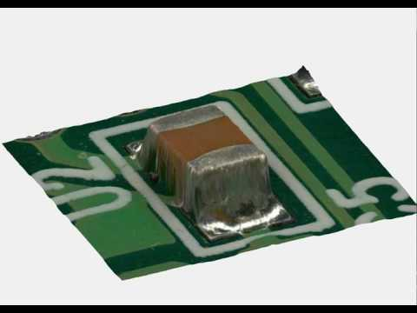

Slide 7
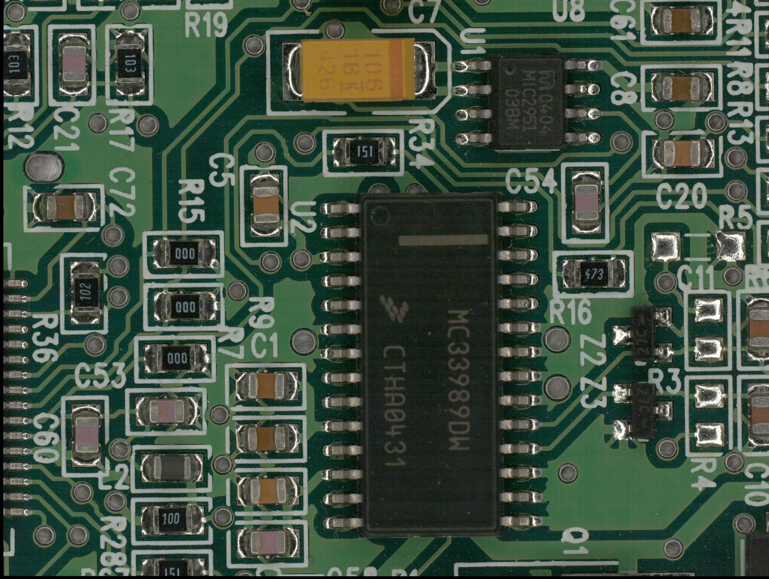
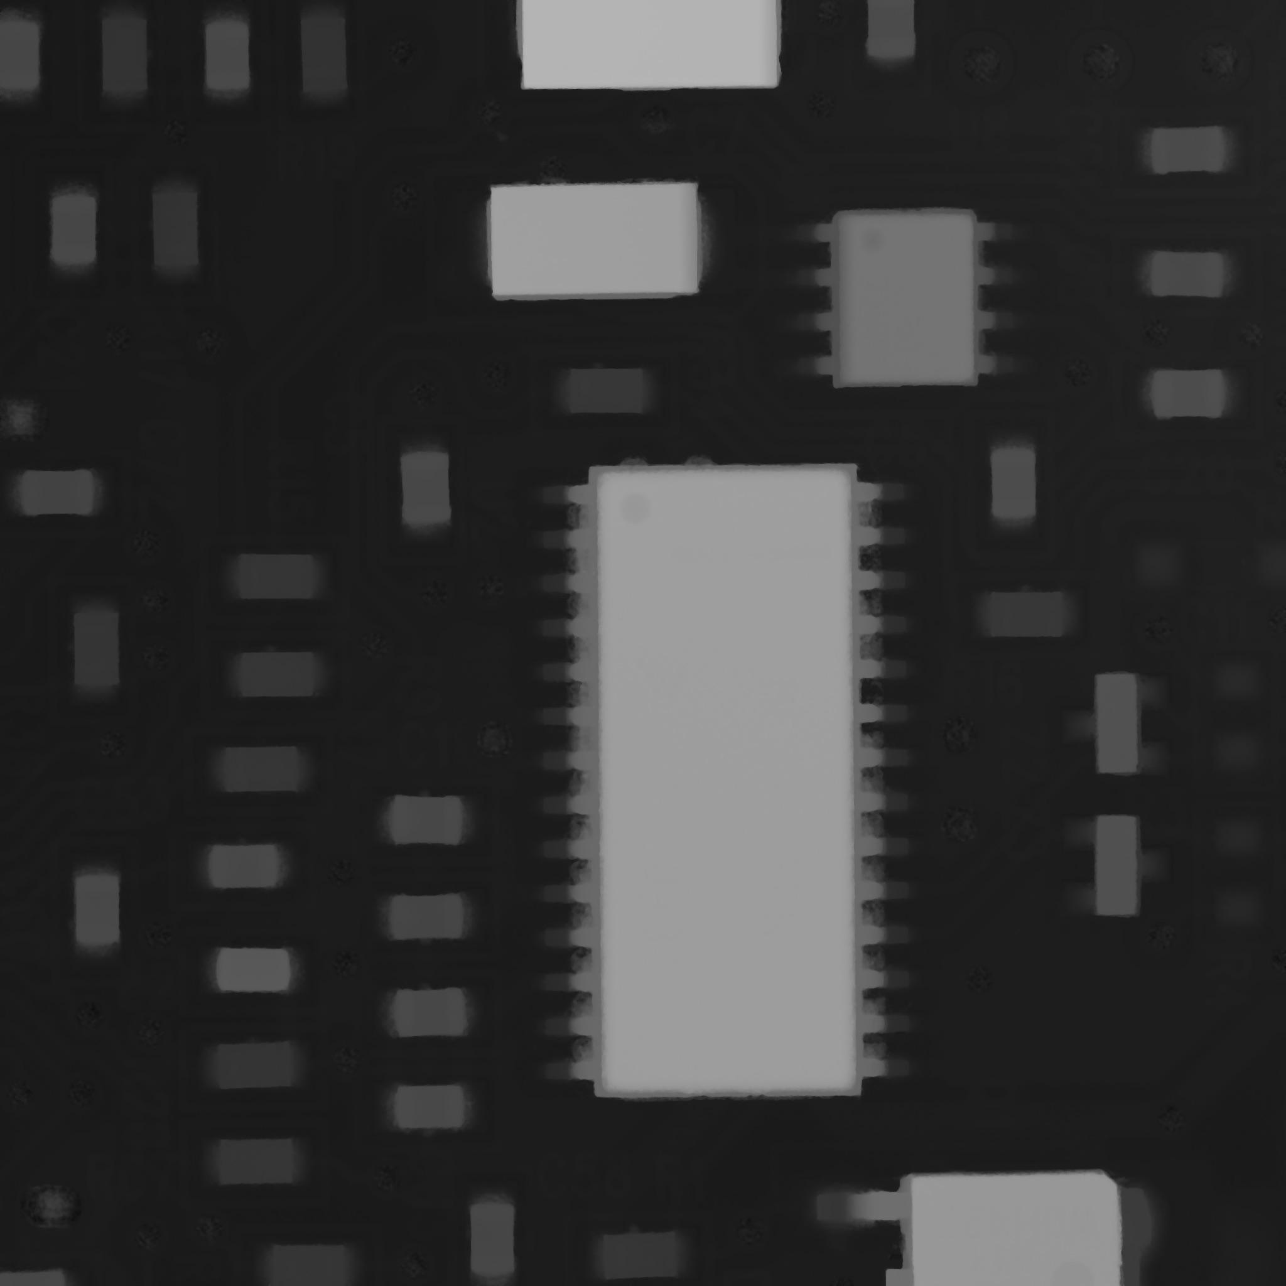
Our Data
Color image; (3072, 4080)
Height map; (2048, 2048)

Slide 8
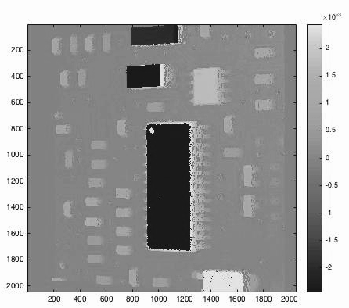
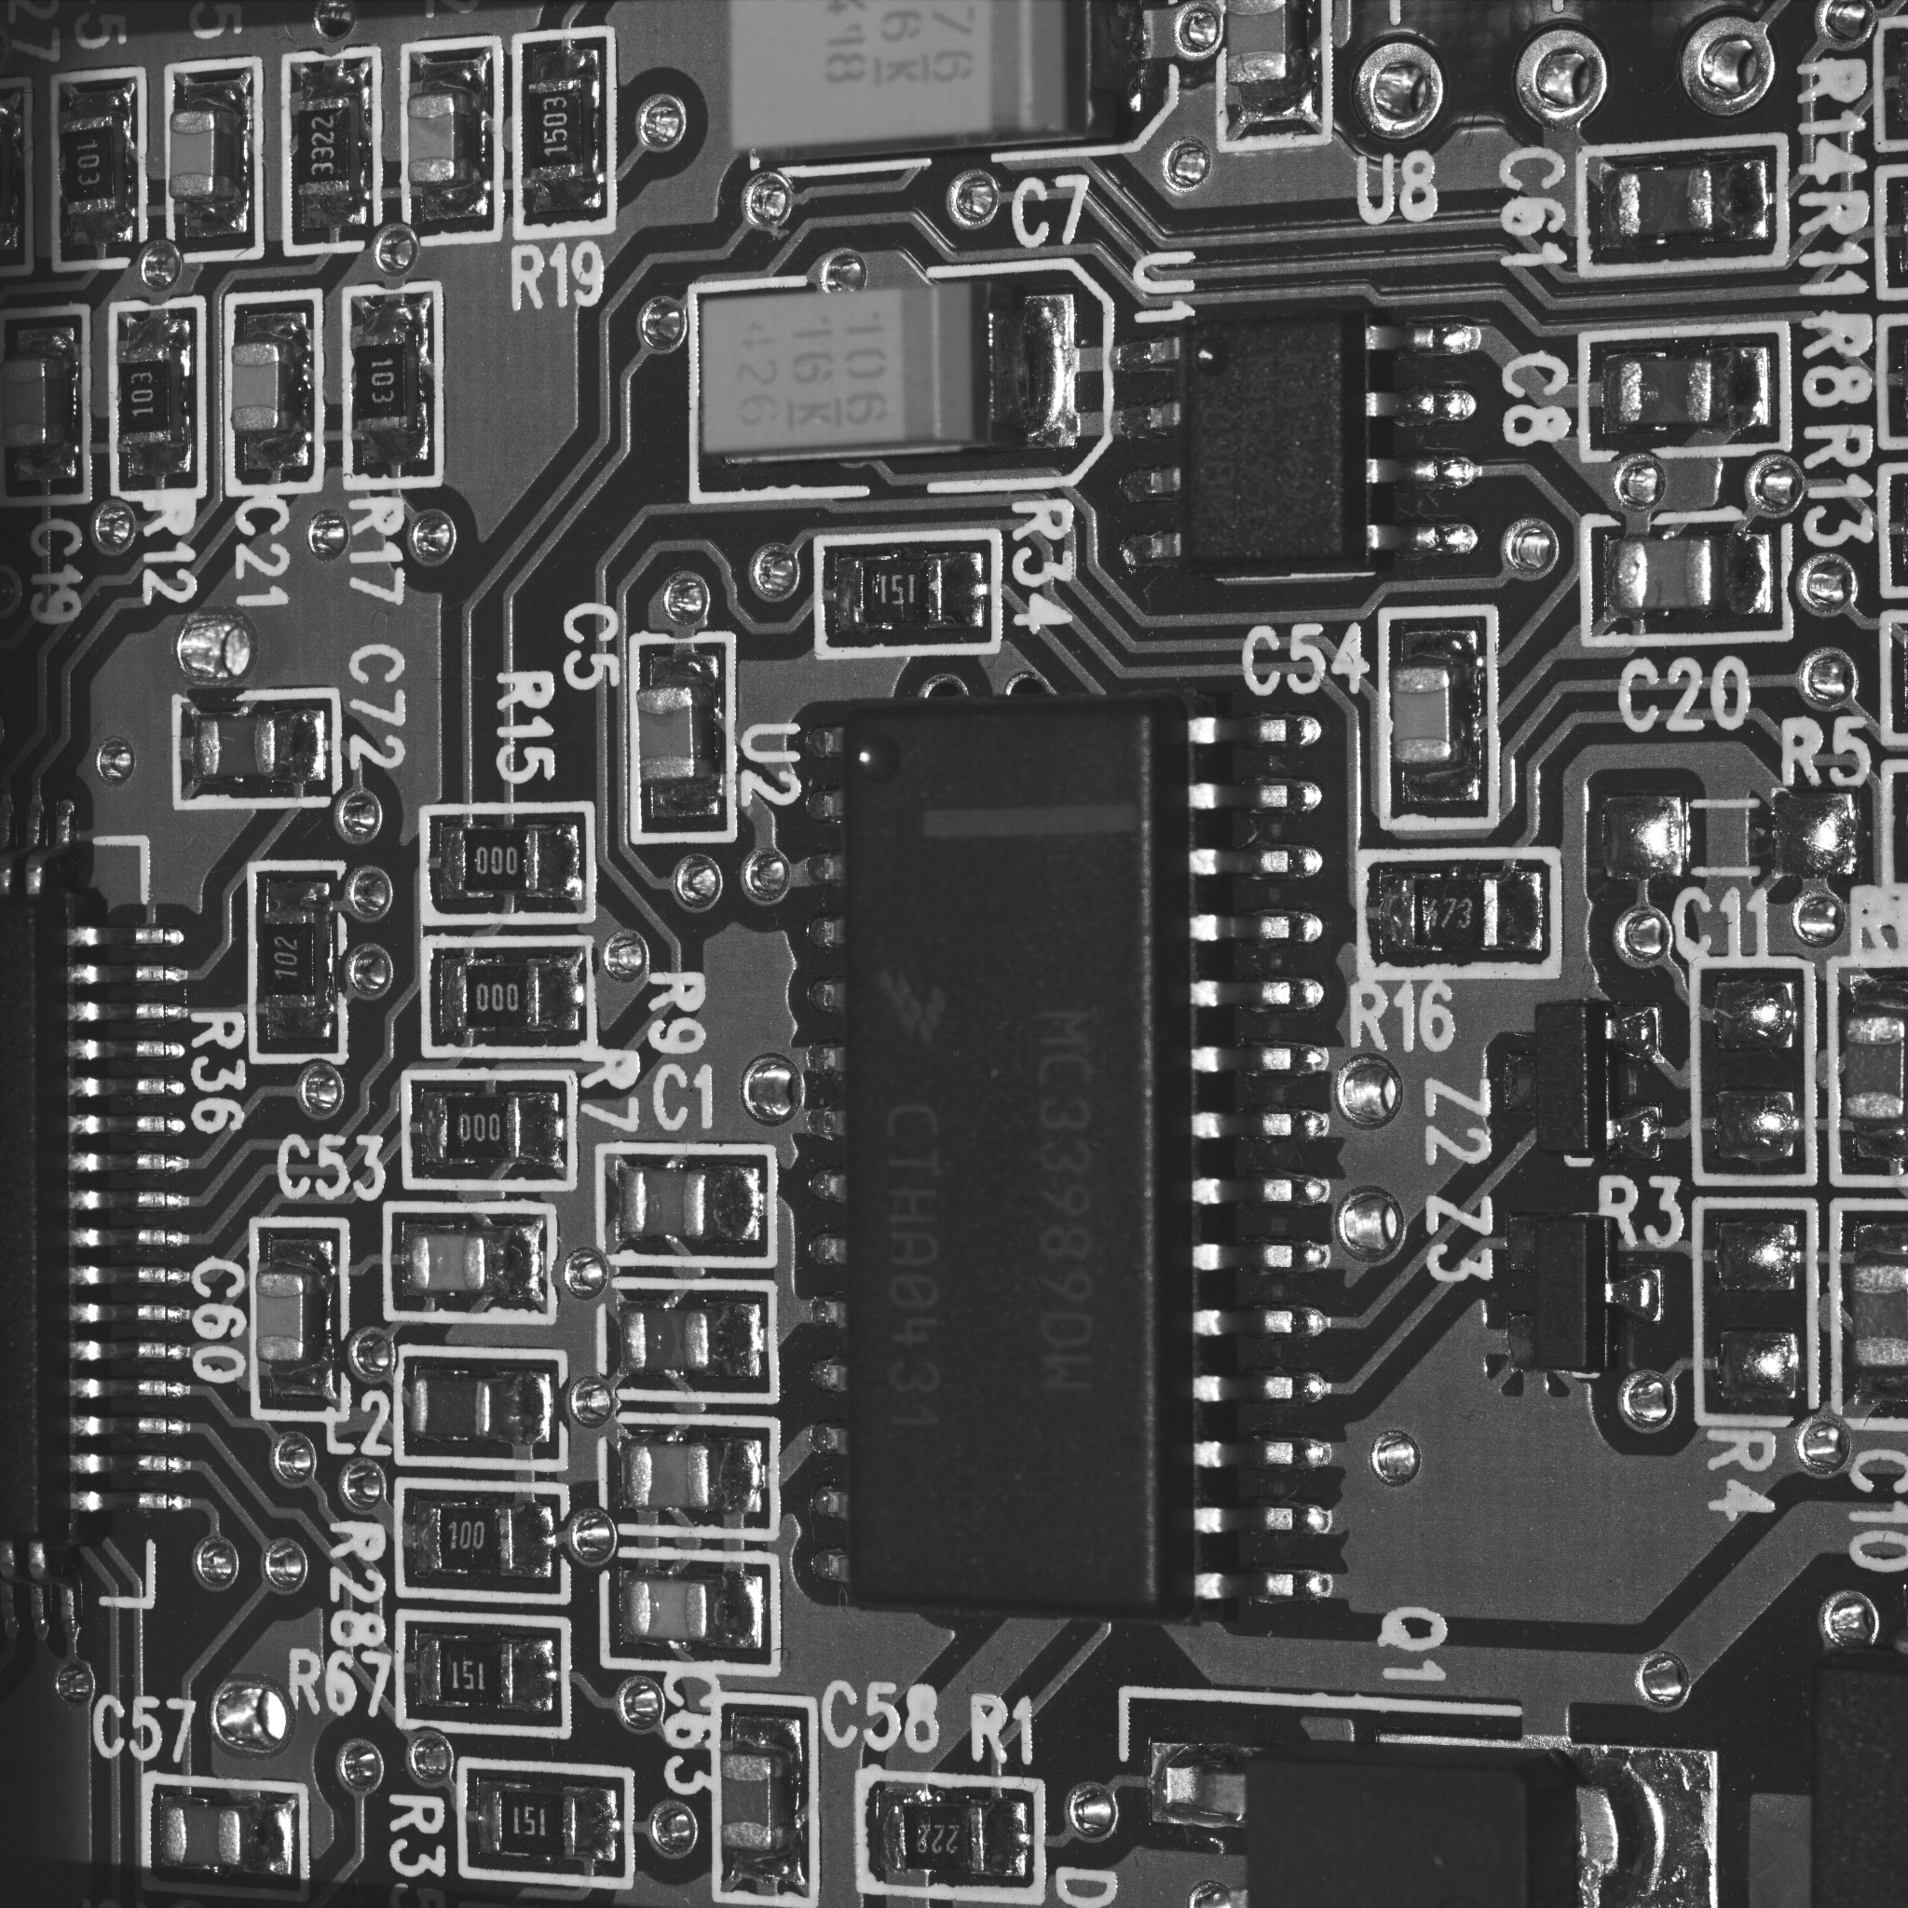
More Side View Data
Height Map
Side View Image

Slide 9
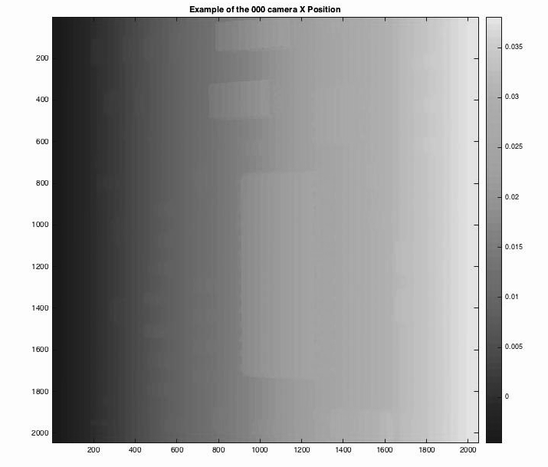
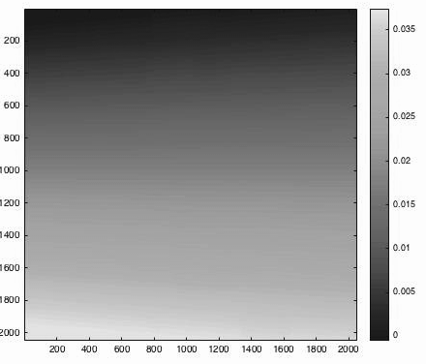
Our Data 2
X point cloud

Slide 10
Y point cloud

Slide 11
Overview
Mathematics behind 3D scanning
Methods we used to improve image
Detecting Vertical Walls
Recoloring Sides
Using Side Images

Slide 12
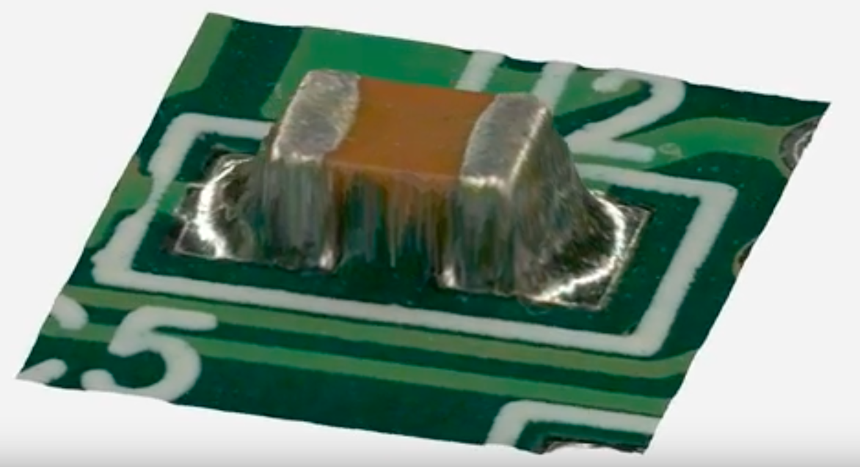
3D Model Construction

Slide 13
3D Model Construction

Slide 14
3D Model Construction

Slide 15
3D Model Construction

Slide 16
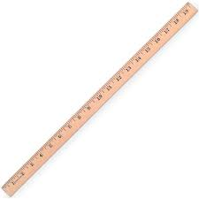
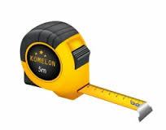
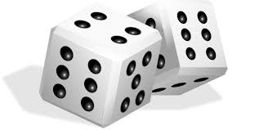
How is the Height Map Found?
?

Slide 17
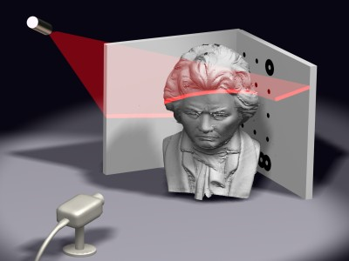
Laser Scanning
Light shined at object
Line will be deformed from camera’s view

Slide 18
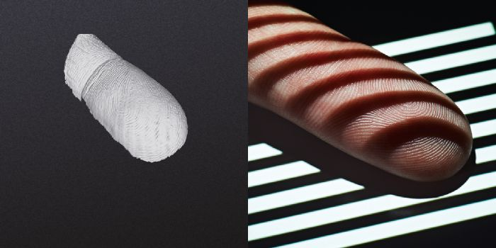
Structured Light Scanning
Known patterns of light
More efficient than single-line laser

Slide 19
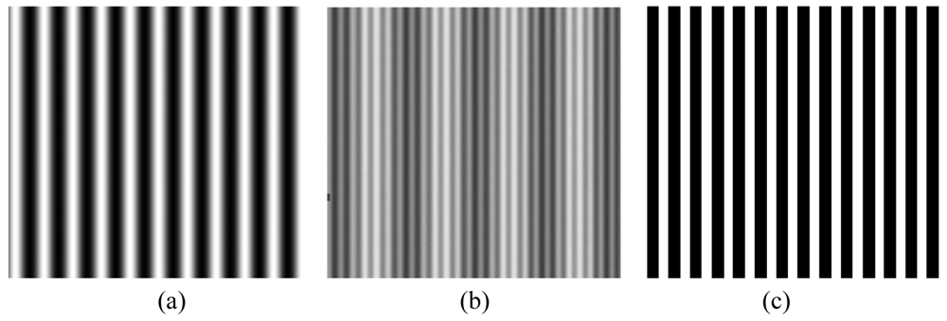
Fringe Patterns
vs.
alternating fringe pattern
sinusoidal fringe pattern
Notes:
If you use a sinusoidal fringe pattern, it’s already blurred
Why use SF? If you pass it through any material, a SF pops up
Zebra blurs towards SF → optical design because significant harder. Possible but super expensive lens
SF get preserved as SF→ Math is easy, consistent; easier to make SF, cost effective; fewer images required for SF to get same quality as when using zebra
Zebra gets info from lines, SF gets info from entire image; important because speed is critical in these things

Slide 20
Phase Shift
Notes:
If you use a synusoidal fringe pattern, it’s already blurred
Why use SF? If you pass it through any material, a SF pops up
Zebra blurs towards SF → optical design because significant harder. Possible but super expensive lens
SF get preserved as SF→ Math is easy, consistent; easier to make SF, cost effective; fewer images required for SF to get same quality as when using zebra
Zebra gets info from lines, SF gets info from entire image; important because speed is critical in these things

Slide 21

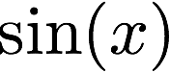
Phase Shift

Slide 22
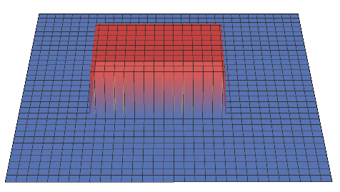
Phase Shift

Slide 23


Phase Shift

Slide 24
Phase Shift
(a,b)
(a,b)

Slide 25
Phase Shift
(a,b)
(a,b)

Slide 26
Phase Profilometry
Original

Slide 27
Phase Profilometry
Original
Camera

Slide 28
Phase Profilometry
Original
Camera
Single image row:

Slide 29
Phase Profilometry
Shifted light pattern seen by camera

Slide 30
Phase Profilometry
Shifted light pattern seen by camera
Solve for phase shift

Slide 31
Phase Profilometry
camera
projector
Notes:
Scanner vs. projector?
John used digital light projector

Slide 32
Phase Profilometry
camera
projector
Notes:
Scanner vs. projector?
John used digital light projector

Slide 33
Phase Profilometry
camera
projector
θ
Notes:
Scanner vs. projector?
John used digital light projector

Slide 34
Phase Profilometry
Original
Camera

Slide 35
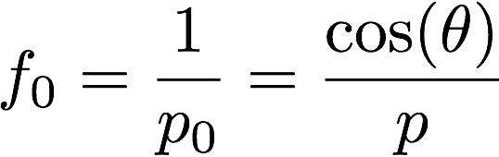
Phase Profilometry
Original
Camera
p
θ
p_{o}

Slide 36
Phase Profilometry
camera
projector
Notes:
Scanner vs. projector?
John used digital light projector

Slide 37
Phase Profilometry
camera
projector
Notes:
Scanner vs. projector?
John used digital light projector

Slide 38
Phase Profilometry
camera
projector
H
Notes:
Scanner vs. projector?
John used digital light projector

Slide 39
Phase Profilometry
camera
projector
C
D
H
Notes:
Scanner vs. projector?
John used digital light projector

Slide 40
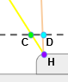
Phase Profilometry
x + s(x,y)
x

Slide 41
Phase Profilometry
camera
projector
C
D
H
Notes:
Scanner vs. projector?
John used digital light projector

Slide 42
Phase Profilometry
camera
projector
L
C
D
-h(x,y)
H
Notes:
Scanner vs. projector?
John used digital light projector

Slide 43
Phase Profilometry
camera
projector
L
L - h(x,y)
C
D
-h(x,y)
H
Notes:
Scanner vs. projector?
John used digital light projector

Slide 44
Phase Profilometry
camera
projector
d
L
L - h(x,y)
C
D
-h(x,y)
H
Notes:
Scanner vs. projector?
John used digital light projector

Slide 45
Phase Profilometry
camera
projector
d
L
L - h(x,y)
C
D
-h(x,y)
H
Notes:
Scanner vs. projector?
John used digital light projector

Slide 46
Phase Profilometry
camera
projector
d
L
L - h(x,y)
C
D
-h(x,y)
H
Notes:
Scanner vs. projector?
John used digital light projector

Slide 47
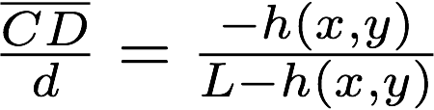
Phase Profilometry
camera
projector
d
L
L - h(x,y)
C
D
-h(x,y)
H
Notes:
Scanner vs. projector?
John used digital light projector

Slide 48
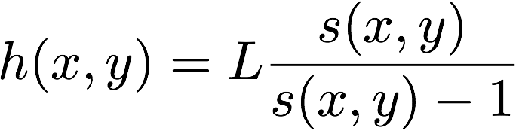
Phase Profilometry
camera
projector
d
L
L - h(x,y)
C
D
-h(x,y)
H
Notes:
Scanner vs. projector?
John used digital light projector

Slide 49
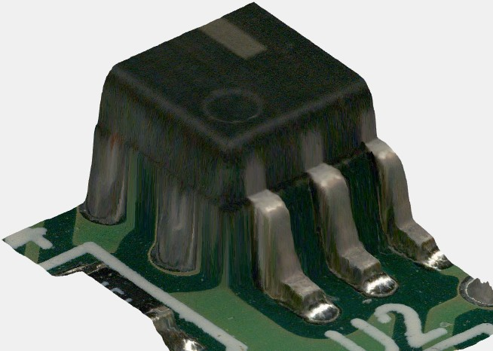
Our Data
Notes:
We knew that the goops happened on vertical walls, so we used the height map to automatically find jumps. Then we used the x,y coordinate from the height map to find to corresponding location in the color image. Once we knew what portion of the color image needed to be changed, coloring the wall was not too hard.

Slide 50
Detecting Jumps
z
Using difference operator to detect jumps in x and y directions.
Difference operator calculates differences between adjacent elements of a vector along its first array dimension.
x
5
5
3
0
0
0 | 3 | 5 | 5
0 | 3 | 2 | 0

Slide 51
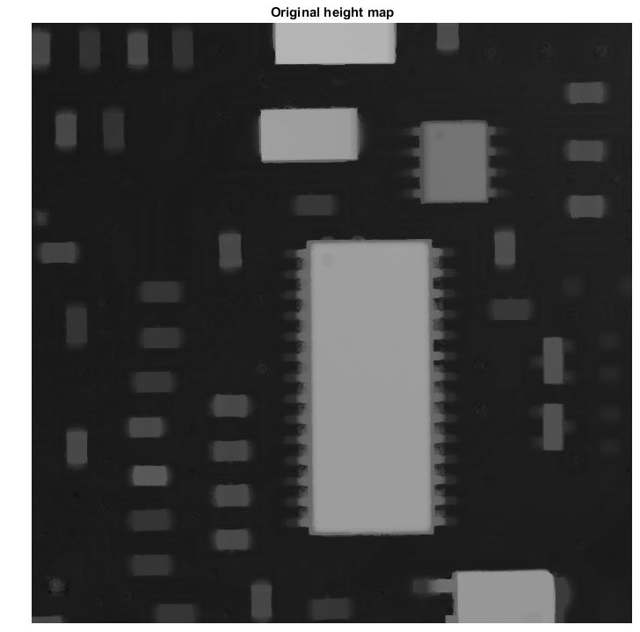
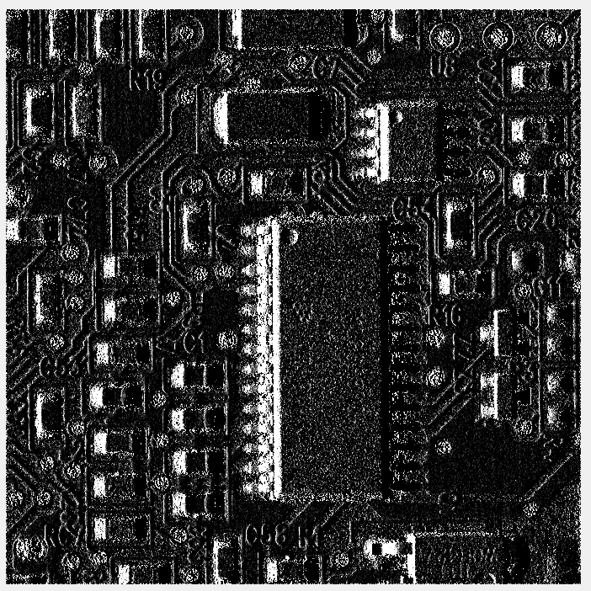
Original Height Map
Height Difference Image
Notes:
Make it gray left right difference one direction

Slide 52
Thresholding heights
Choose a threshold, eliminate small changes in heights.
Height difference >= threshold WHITE
Height< threshold BLACK
Height difference
Notes:
Use heightmap here

Slide 53
How does “Thresholding” work
Original height
0 | 3 | 5 | 5
z
x
Height difference
0 | 3 | 2 | 0
If we set up threshold to 2
5
5
B&W image after thresholding
0 | 1 | 1 | 0
3
0
0

Slide 54
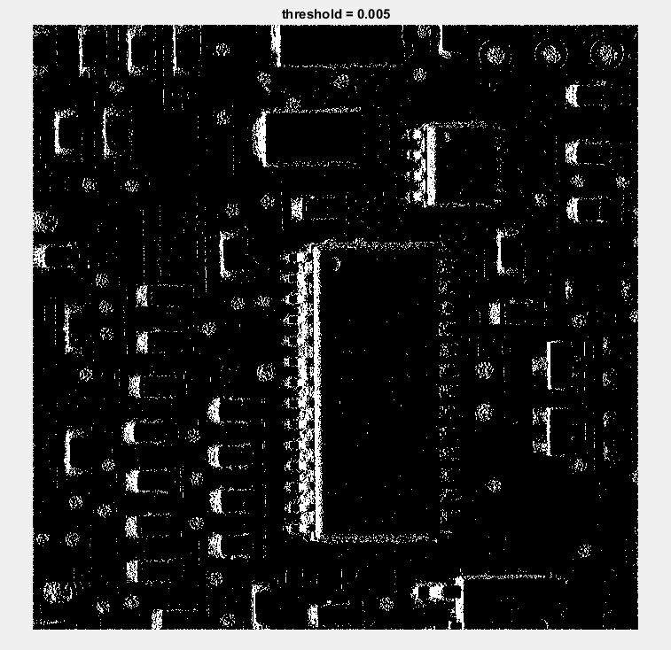
Height difference
Threshold = 0.5% of max height difference

Slide 55
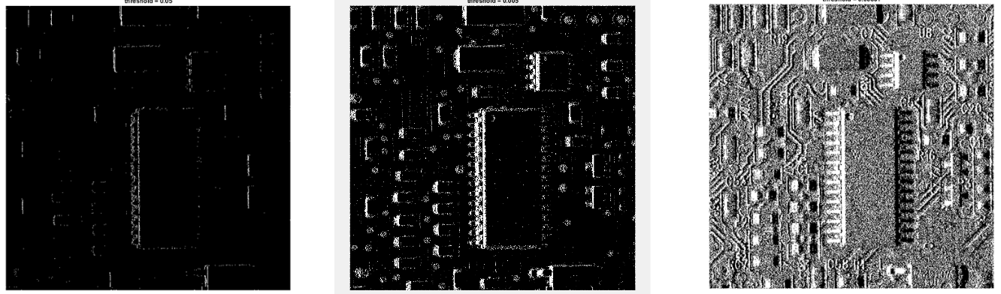
What is a good threshold?
Threshold = 0.05
Threshold = 0.005
Threshold = 0.00001

Slide 56
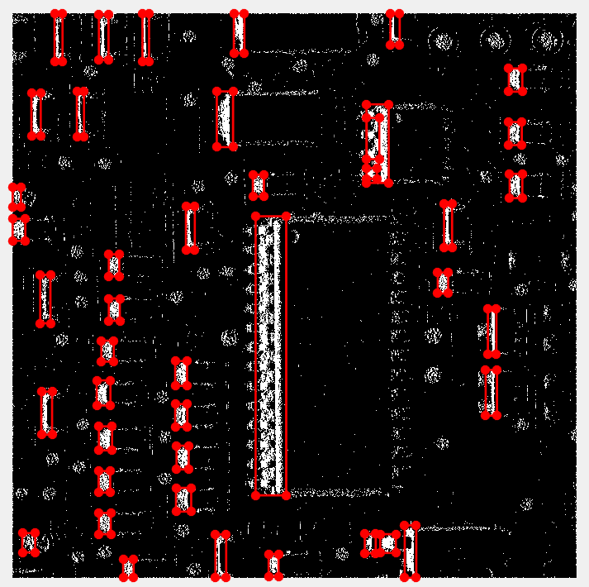

Slide 57
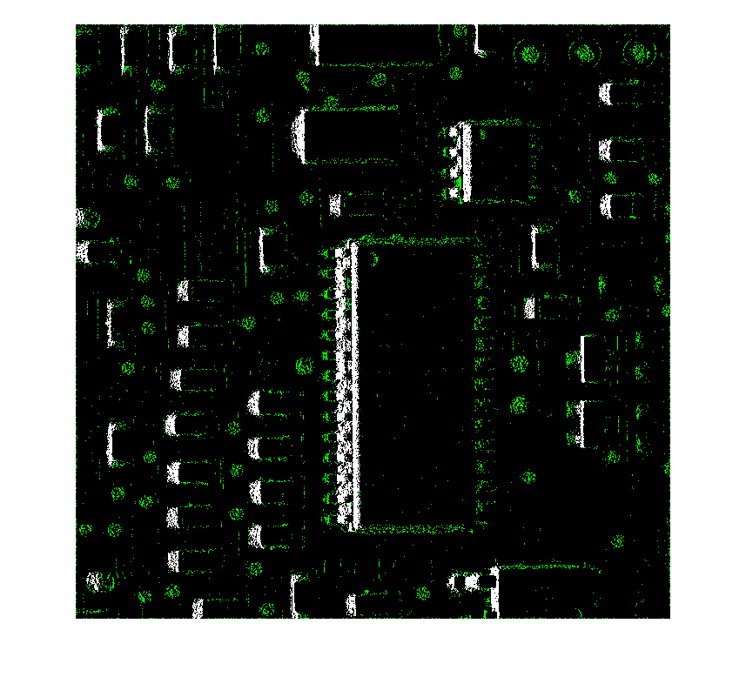
Finding and pruning the connected components
Now we group the points in the binary image into clusters. These clusters we hope will represent the left "sides" of each of the circuit board features.
Set up a pruning value.
Discard connected components having pixels fewer than pruning value.

Slide 58
How “Prune” works
Prune value = 2

Slide 59
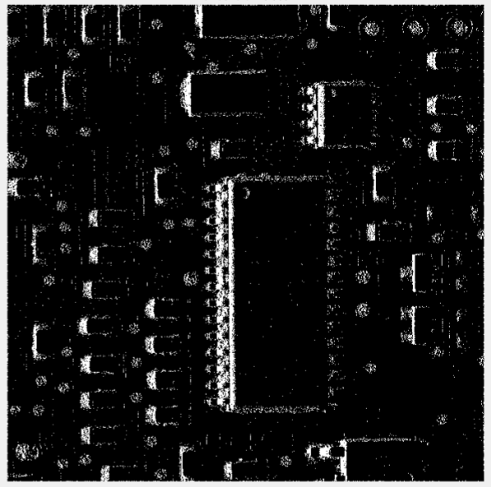
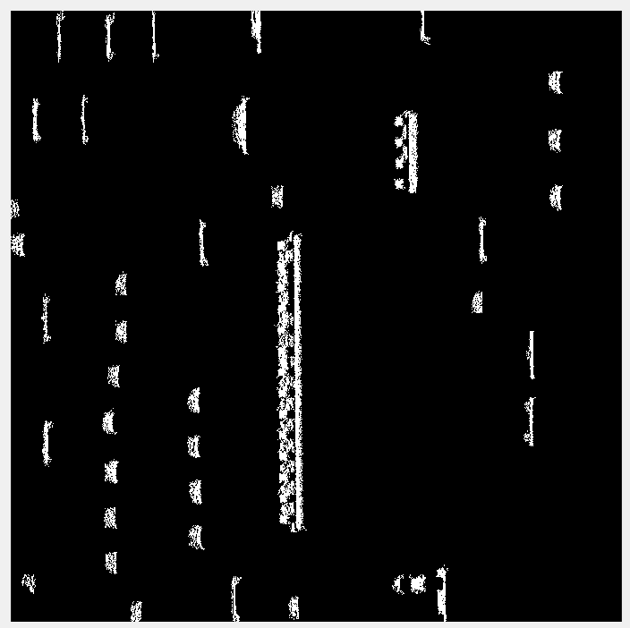
BEFORE
AFTER (PRUNE = 800)

Slide 60
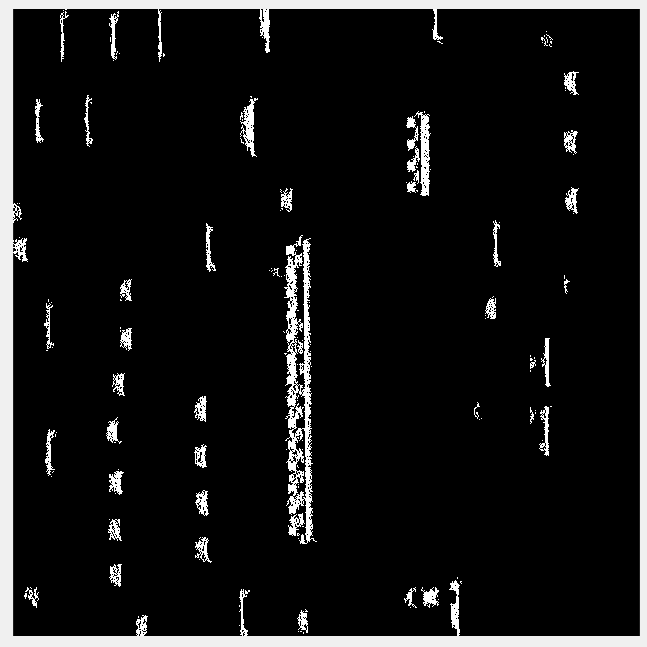
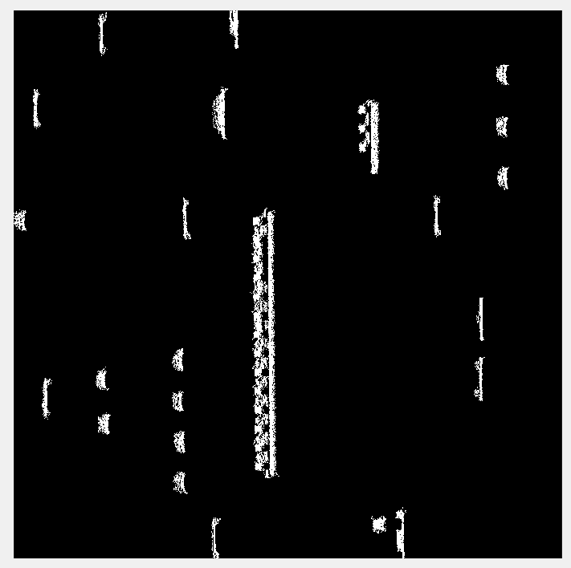
What is a good prune value?
Threshold = 0.005, prune = 300
Threshold = 0.005, prune = 800
Threshold = 0.005, prune = 1800

Slide 61
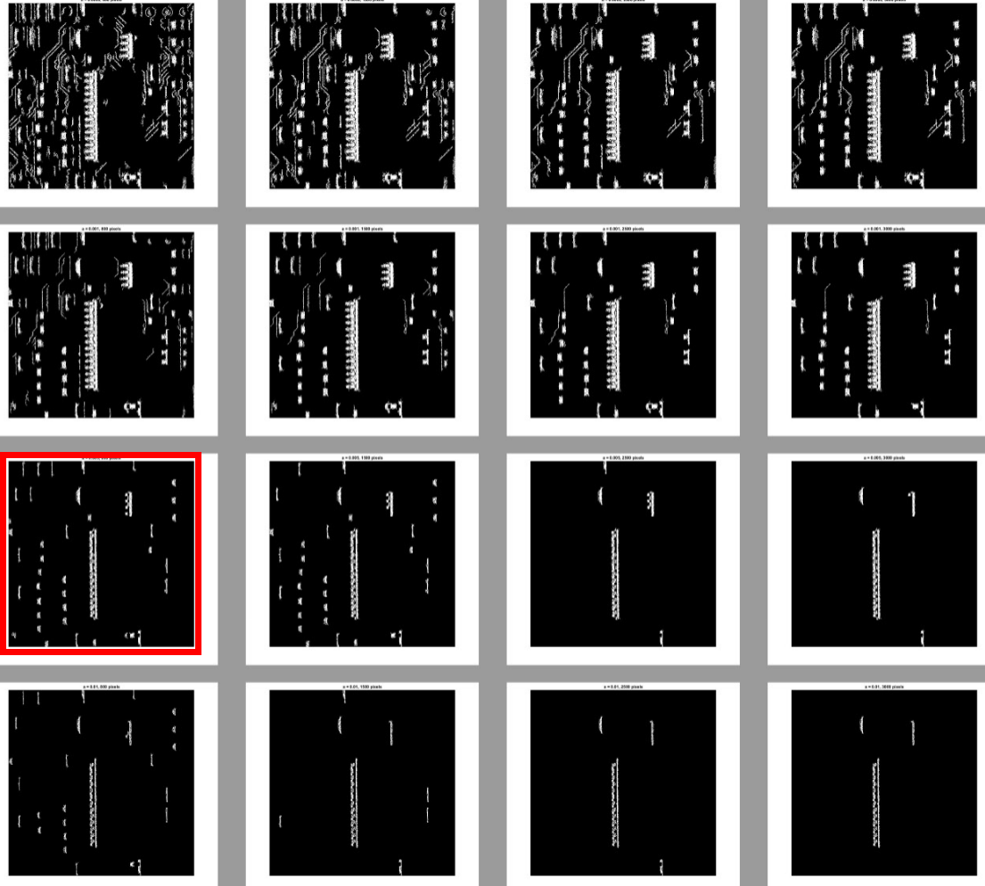
Prune = 800
Prune = 1500
Prune = 2500
Prune = 3000
Threshold = 0.0005
Threshold = 0.001
Threshold = 0.005
Threshold = 0.01
Notes:
Explain variable

Slide 62
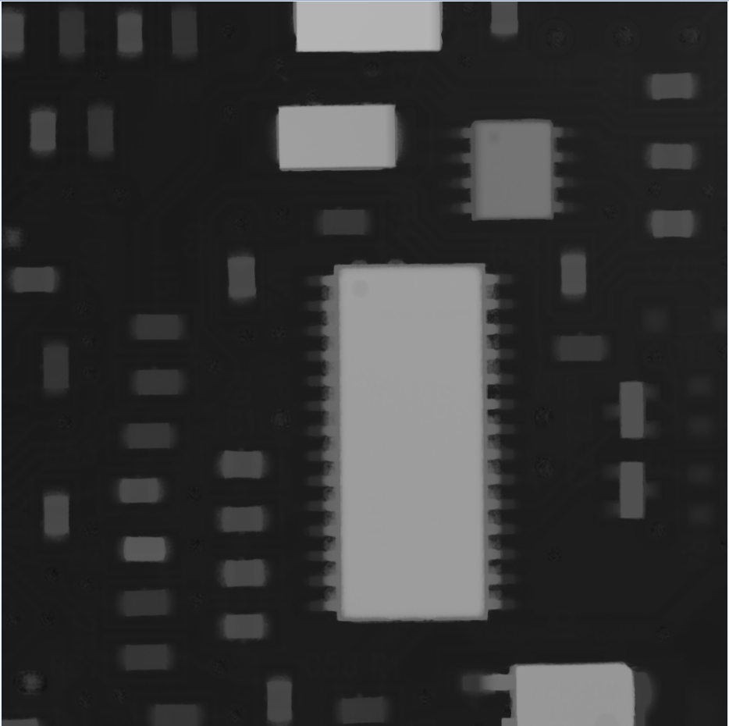
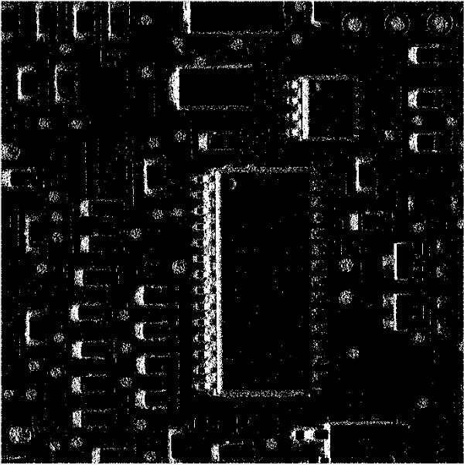
Compare with heightmap /oirginal picture
Original Height Map
Height Difference
After Thresholding
After Pruning
Notes:
Add diff

Slide 63
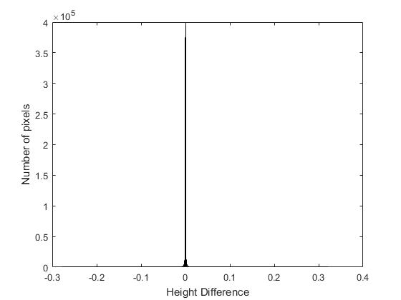
Challenge:How to Find Proper Threshold and Pruning value?
Notes:
Explain this histogram add
Show original histogram
cluster

Slide 64
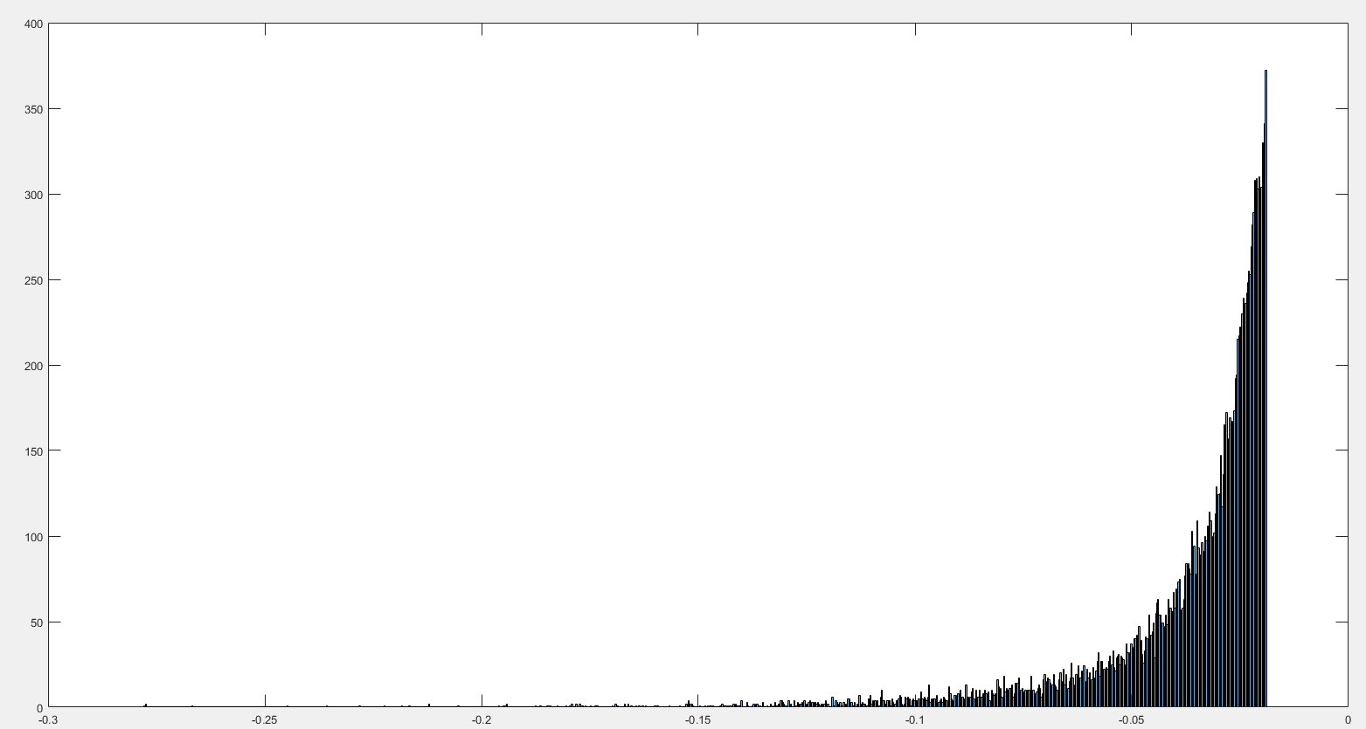
Number of pixels
Height
Notes:
Explain scale

Slide 65
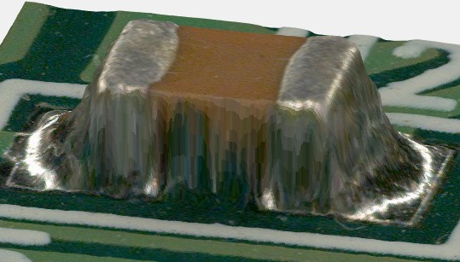
Coloring!
Doesn’t require more images or a lot of processing
Quick
Original Image 1
Original Image 2

Slide 66
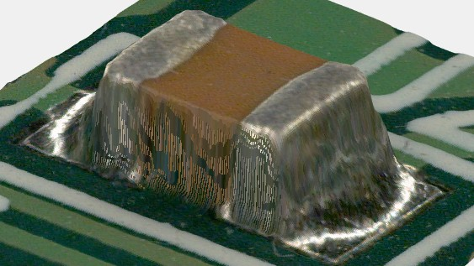
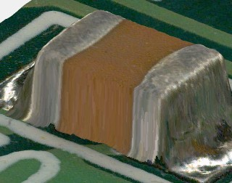
Pre-processing part 1
Resizing/Refining
Using the original image created gaps because the height map pixels were larger than the color image and there was no one-to-one correspondence: (2048,2048) vs. (3072, 4080)
Notes:
Using the original image created gaps Because the height map (2048, 2048) was smaller than the color image (3072, 4080),
Think of height map pixels as a net, a bigger net would show more color underneath, while a finer net cover an object better.
No one-to-one correspondence between images of different sizes

Slide 67
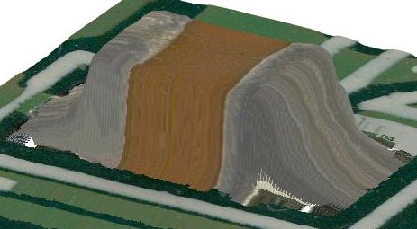
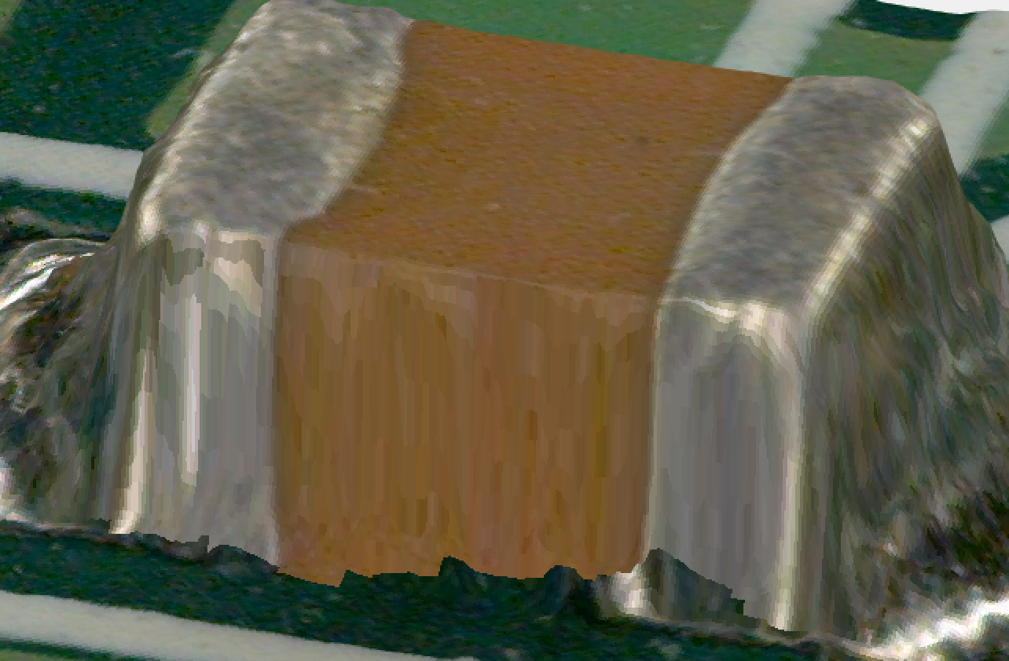
Pre-processing part 2
Thresholding
Having a bad threshold resulted in modifying pixels that shouldn’t have been.

Slide 68
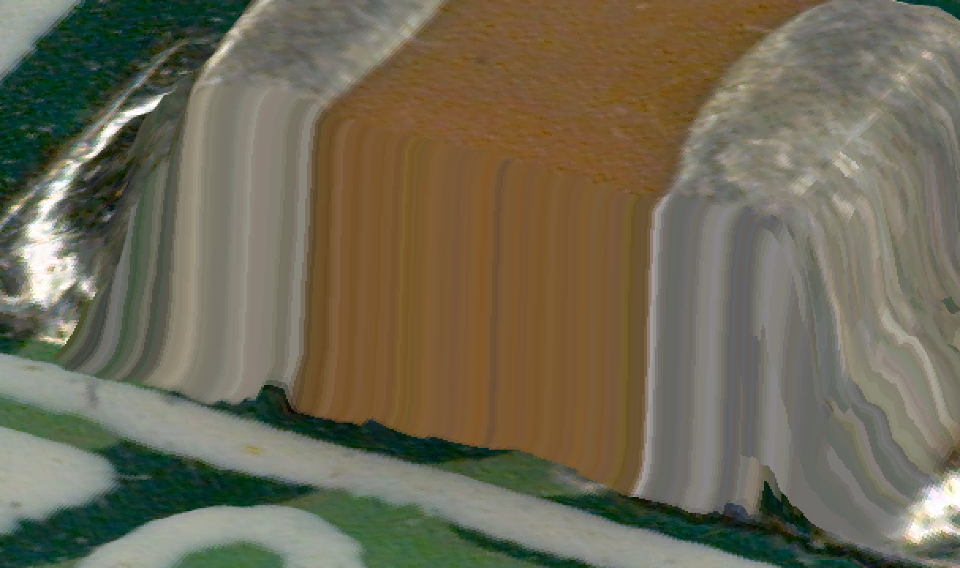
Simplest method

Slide 69
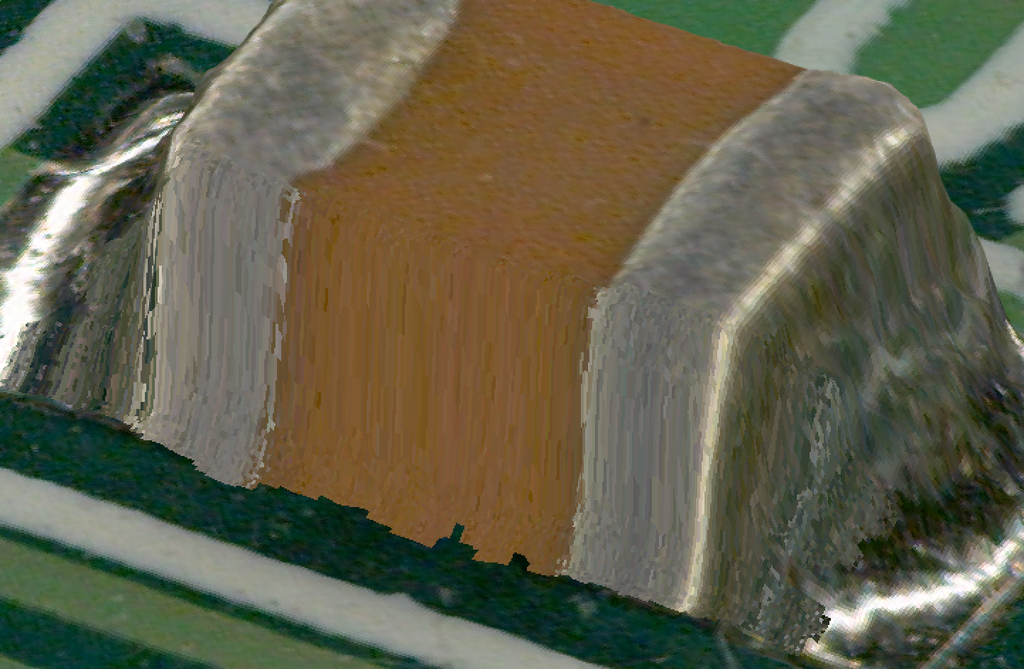
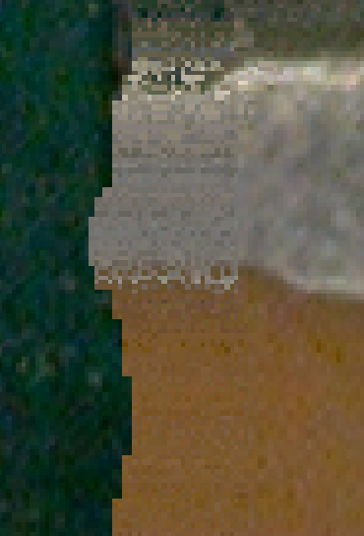
Add randomness?

Slide 70
Add randomness?

Slide 71
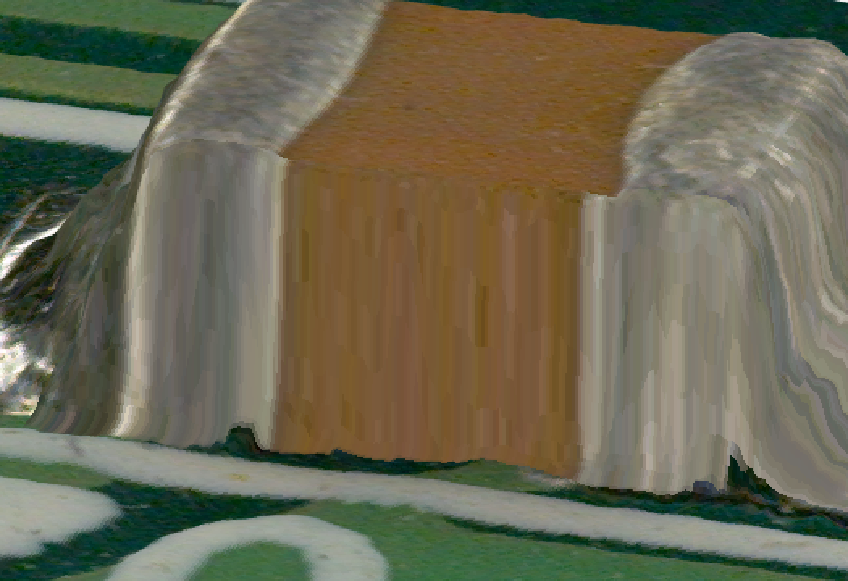

Copy-and-paste?

Slide 72
Copy-and-paste

Slide 73

Copy-and-paste Version 2
Mirror the copied image!

Slide 74

Small Recap
Refined height map
Detected jumps using a smaller threshold to avoid false positives
Colored walls using mirrored portion of image from surface
Filled in the spaces below

Slide 75

Comparison + Next steps

Slide 76


The idea: Transplant from Side View

Slide 77

Create a Dictionary between overhead and side images
Step 1:
Allow us to find a selected feature from overhead image in the side view
All we need is row and column range from overhead and side camera direction

Slide 78


Creating the Dictionary
X point cloud
Y point cloud

Slide 79

Creating the Dictionary

Slide 80


Slide 81


Use Height Jump Data to access dictionary
Step 2:
We can use Ming’s work to find the ranges of the Height jump

Slide 82

Paste the Image
Step 3:
access to overhead heightmap information to paste on side image
Incorporate previous steps into surface rendering software, thus automating the whole process

Slide 83


Notes:
Rgb = cat(3,y,y,y) where y is the gray scale value

Slide 84


Comparison:
Original
With Side image

Slide 85
Where to go from here:
Need automatic Thresholding so grabbing heights function doesn’t need tweaking for each case
Add color to side view image

Slide 86
Conclusion:
Examined how 3D scanners worked mathematically
Isolated vertical walls
Developed 2 approaches to fix the problem given to us by CyberOptics

Slide 87

Thank you to...
Professor Rob Thompson and the Math Department
CyberOptics and John Hoffman
Friends and Family
You all!

Slide 88
Questions?

